Slide 1





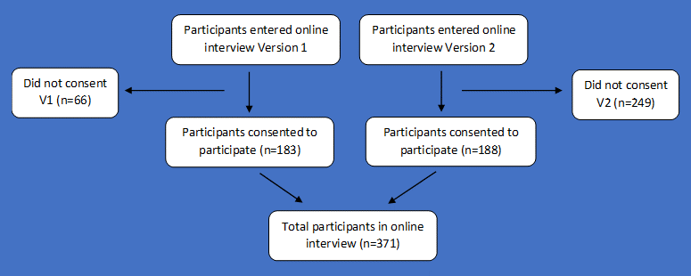
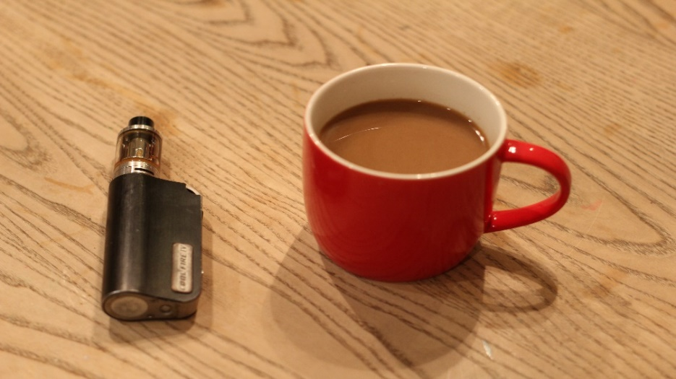



PATTERNS OF VAPING TO SUPPORT LONG TERM ABSTINENCE FROM SMOKING
Dr Caitlin Notley, University of East Anglia, UK, c.notley@uea.ac.uk
Dr Emma Ward, University of East Anglia
Dr Sarah Gentry, University of East Anglia
BACKGROUND
PARTICIPANTS
E cigarettes are the most popular aid to quitting smoking in the UK (1)
Most quits attempts, prior to e cigarettes, result in relapse to smoking (2)
Most vapers use e-cigarettes for smoking cessation or to cut down (3)
We have little understanding of how vapers use e cigarettes to avoid smoking relapse
METHODS
TRAJECTORIES
• Online questionnaire
• Convenience sample
• Quantitative and open ended qualitative responses
• Data collected on socio-demographic characteristics, tobacco use, e-cigarette use, previous quit attempts
Most participants reported their initial device to be either a vape pen (45.8%) or a cig-a-like (38.7%), but their current device to be a mod or tank device (89.4%)
There is a change in the e liquid flavour choices people make over time. Among participants in our survey there was a reduction in the proportion of people using a tobacco flavour (-36.5%, 95% CI -43.5 to -29.6), and increase in the proportion using a fruit, sweet or food flavour (+31.7%, 95% CI 23.3% to 40.0%), from initial to current flavour choice
A simple linear regression was calculated to predict starting nicotine strength based on cigarettes per day (CPD). A significant association was found (=0.106, 95% CI 0.025 to 0.187, p=0.01). Nicotine strength increased by 0.1mg for every extra cigarette smoked per day. The strength of the association reduced slightly but remained statistically significant after controlling for age (=0.872, 95% CI 0.006 to 0.168, p=0.035) and then age and sex (=0.084, 95% CI 0.003 to 0.164, p=0.041)
SMOKING RELAPSE STATUS AND RISK
Those using a mod or tank device, or a vape pen, were significantly less likely to relapse to tobacco smoking than those using a cig-a-like. This difference remained after controlling for age and sex (Mod + tank vs. cig-a-like OR=-2.74, 95% -4.98 to -0.45, p=0.019; vape pen vs. cig-a-like OR=-1.97, 95% CI -3.26 to -0.68, p=0.003).
There was a small but statistically significant inverse association between starting nicotine e liquid strength and tobacco smoking relapse (OR=-0.231, 95% CI -0.460 to -0.0027, p=0.047).
CONCLUSIONS
The way in which people use e-cigarettes has a significant impact on whether they are likely to relapse to smoking or not
Relapse was much more likely among people initiating e-cigarette use with a cig-a-like, compared with other types of device
Those who do not begin by using an adequate nicotine strength, in terms of their previous cigarettes per day and the power of the device they choose, may be more likely to relapse
Results report real world patterns of e-cigarette use, with most responders moving from higher strength, earlier generation devices and using tobacco flavoured e-liquid, onto lower strength, later generation devices, choosing sweet/food flavour e-liquids
LIMITATIONS
Convenience sampling of e-cigarette users likely over-represents those who were successful quitters and so wished to share their experiences
Many participants did not complete all questions, meaning some of the analyses are likely to be underpowered, and some potential confounders could not be included in regression models
REFERENCES
West, Robert & Brown, Jamie. Smoking in England 2017-2014: Smoking toolkit study [Internet]. 2015 [cited 2017 Nov 15]. Available from: www.smokinginengland.info
Hajek P, Stead LF, West R, Jarvis M, Hartmann-Boyce J, Lancaster T. Relapse prevention interventions for smoking cessation. Cochrane Database Syst Rev. 2013 Aug 20;(8):CD003999.
McNeill A, Brose LS, Calder R, Bauld L & Robson D (2018). Evidence review of e-cigarettes and heated tobacco products 2018 A report commissioned by Public Health England.
COI statement: No conflicts of interest to declare.

