Slide 1
Nicotine in everyday life – from addiction to recreation
Rethinking societal and popular views of nicotine
Dr Caitlin notley
Notes:
I am very happy to be here, and thank you to the organisers for hosting such a lively and thought provoking conference. In my talk today I want to kick off this plenary session on new scientific understandings of nicotine by reflecting on the way in which society and culture currently think about nicotine use in everyday life. As a Social Scientist, I am fascinated with social and cultural influences on patterns of consumption, and as I work within a medical school particularly considering the consequences of social and cultural influences on human behaviour an implications for medical treatment or intervention.

Slide 2





Dr Caitlin Notley
Dr Emma Ward, Dr Lynne Dawkins,
Professor Richard Holland
With thanks to Sarah Jakes and Dr Isabel Greaves
Competing interests - No tobacco industry, electronic cigarette company or pharmaceutical industry funding
@Addictionuea
Notes:
I have come to think a lot about this topic in the last few years through undertaking work funded by CRUK. The Ectra study is a mixed methods study exploring trajectories of e cigarette use and particularly focused on the role that vaping may play in long term smoking relapse prevention – so this is a longitudinal study exploring not only how alternative nicotine products can help smokers to quit, but understanding the ways in which e cigarettes may support long term smoking abstinence. No conflicts of interest to declare in undertaking this talk or in relation to the findings of the Ectra study. I would also like to take the opportunity to acknowledge the fantastic research team that I work with, particularly Emma, Lynne and Richard, as well as Sarah Jakes NNA, and CRUK as finders of the study. Please feel free to tweet but keep it clean!

Slide 3
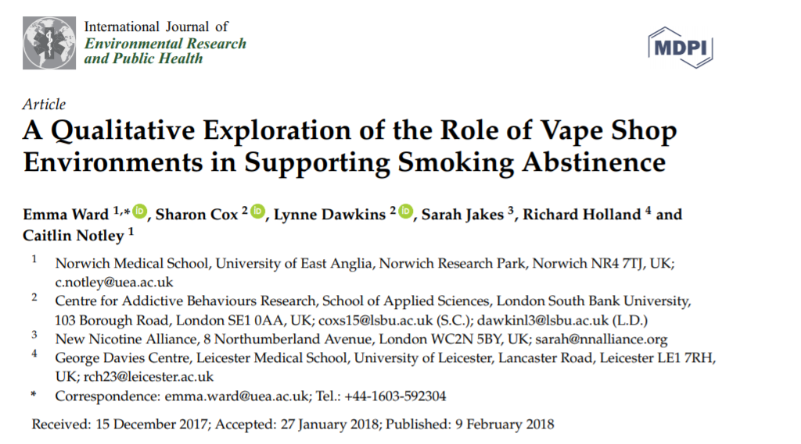
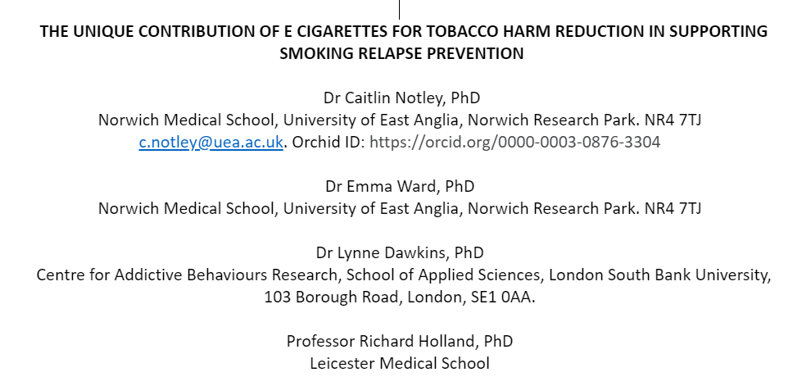
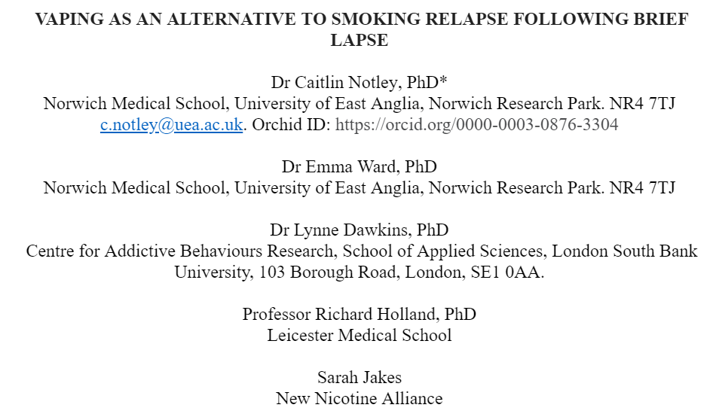
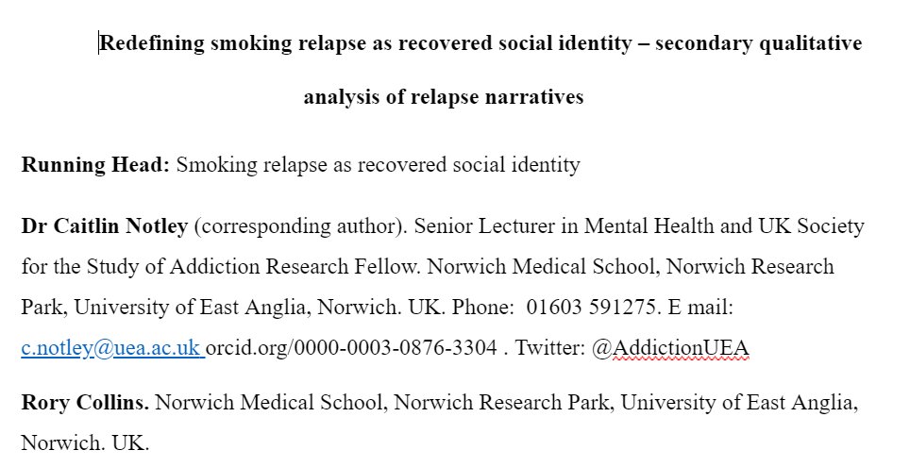
PUBLICATION DATE 20TH June 2018
ACCEPTED FOR PUBLICATION
IN SUBMISSION
Notes:
So far we have had 3 papers published or in process from the ECtra study, and a poster here for display at the conference. Qualitative study hypothesising the great potential of vaping to support long term smoking abstinence through meeting user needs beyond nicotine addiction, really considering specifically the social, cultural and identity needs that are met through e cigarette use, and discussing the importance of pleasure

Slide 4
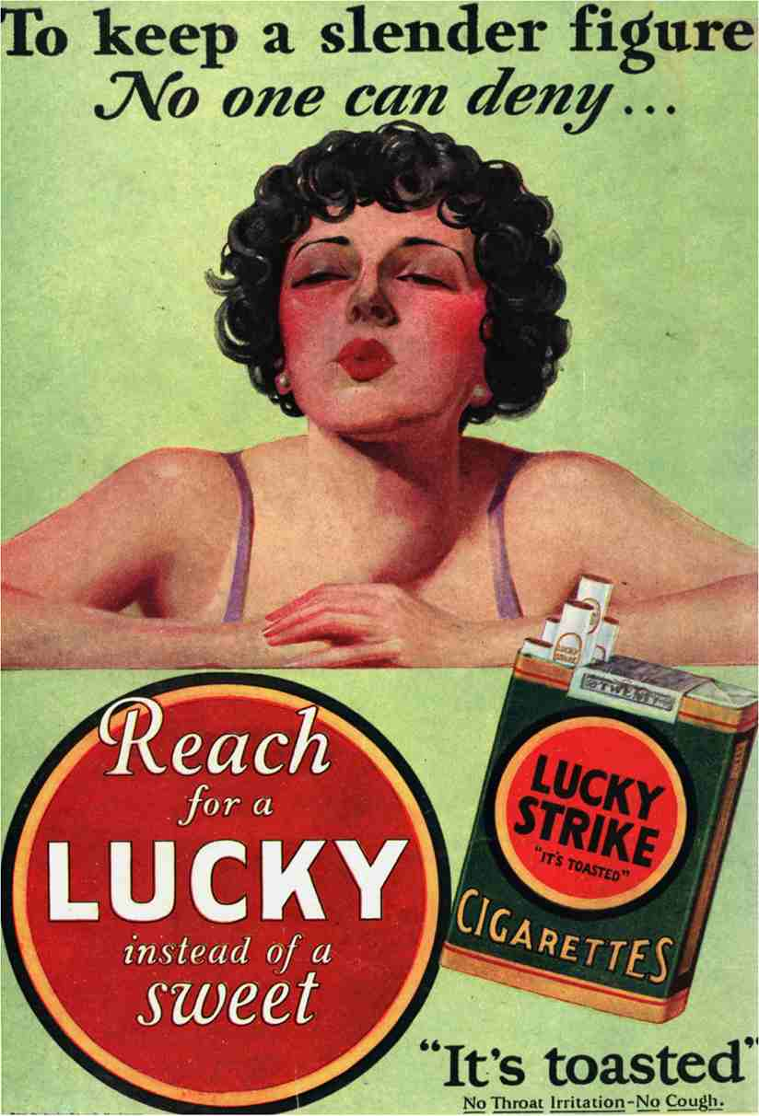
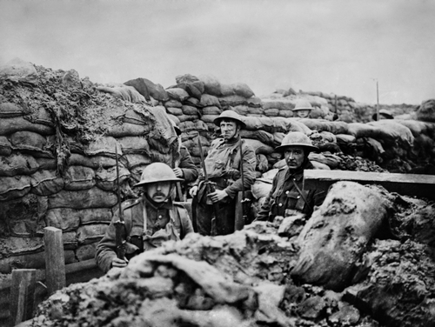
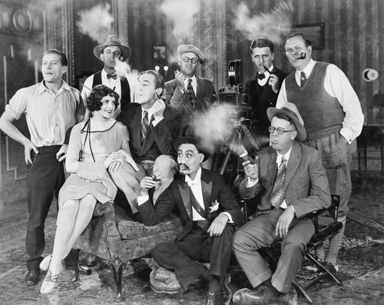
How has ‘society’ seen nicotine addiction historically, and does it matter?
1925
1930s
WW11914-1918
Notes:
The central thesis of this talk is that the way we (‘society’ – academics, scientists, members of the public )view nicotine use and particularly nicotine addiction is historically situated and driven by the dominant discourses circulating in society at any one time. This matters a great deal. Humans are social creatures. They want to belong, to feel a sense of identity and solidarity with a group. This might be a minority sub-group, or the wider general population. Humans want to be accepted and feel that they are behaving in a way that is socially acceptable. They also seek to engage in activities that help establish and maintain group bonds. In previous work on the role of smoking relapse I have argued that nicotine use through cigarette smoking may be seen as a symbolic form of social exchange that helps to maintain and solidify group membership. So the way in which society views nicotine matters very much, as it impacts on individual consumption behaviours, and has consequences for whether we see nicotine use as problematic or not, and how we respond to it

Slide 5
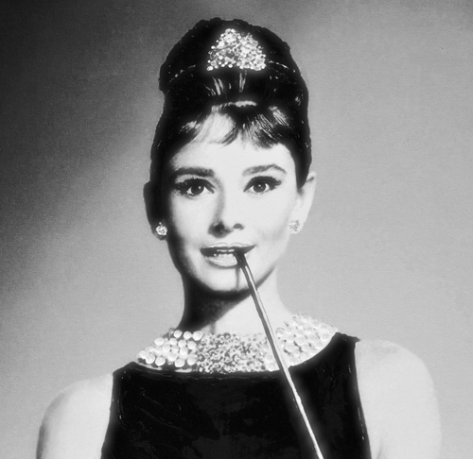
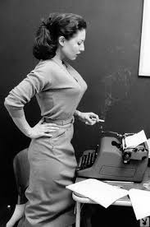


Not all views are equal – creating and maintaining inequalities
1950s
Notes:
Although in the 1940s and 1950s nicotine use through smoking was glamorised by prominent Hollywood stars, at the same time I would argue that women particularly have historically been viewed in relation to nicotine addiction as being weak of character, or morally corrupt. There is an assumption that women are somehow more vulnerable to addiction that is apparent in historical cultural discourse, and a sense of blaming for this…nicotine addiction is seen as a way of coping with the stress of the workplace…nicotine addiction associated with other forms of drug addiction and the moral connotations that that conveys, and nicotine addiction associated with sex working, another way in which women are seen as morally corrupt

Slide 6
From recreation to addiction and back to recreation
Nicotine use as recreational / functional. 1940’s-1950s
Nicotine use as addiction. Seen as psychological weakness. 1960s, 1970s
Nicotine use
Nicotine use
removed from
to recreation???
smoking. Return
through
tobacco smoking
recognized by society
as harmful to health. A medical problem requiring treatment. 1980s, 1990s
Present day
Notes:
So, my core argument is that we have moved since the 1940s and before, from seeing nicotine addiction, primarily through smoking, as a form of recreation, as a treat, something glamorous, through to an addiction with negative social connotations, particularly for women, and now perhaps, at this current point in history, we may again begin to be seeing nicotine use or addiction as recreational, since it can now be removed from the mode of delivery of combustion through tobacco smoking that we now know to be so harmful to health. This is perhaps a reflection of the cyclical and reactionary nature of societal views, which may very likely be politically driven or aligned to the dominant political discourses of the time. Each viewpoint is a direct reaction to what has gone before. Interestingly I would argue that societal views have, until more recently, been almost divorced of medical ‘evidence’ and interestingly we see societal attitudes to e cigarettes recently again being divorced from medical evidence… first seminal study by Doll linking tobacco smoking to lung cancer was published in 1950 but not really until the 1980s that widespread public acceptance of the harms of smoking began to make a significant impact on population prevalence of smoking.
(Doll R, Hill AB. Smoking and carcinoma of the lung; preliminary report. Br Med J 1950 ;2:739–48.)

Slide 7


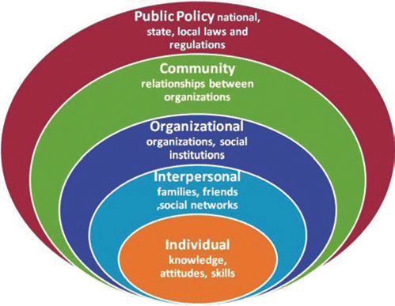






Causes & consequences
‘Media discourse is a broad term which can refer to a totality of how reality is represented in broadcast and printed media’ (O’Keefe, 2006:1*)
*O’Keefe, A (2006) Investigating Media Discourse. London: Routledge.
Notes:
This talk shamelessly and rather unsystematically uses images for effect and to demonstrate the central thesis of the talk, that societal views are historically situated and driven by dominant cultural discourses, which in turn impact on behaviour at the individual level. As a social scientist I am most interested in social and cultural influences on behaviour and the way in which societal discourse operates to influences behaviour. I take my definition of ‘societal discourse’ at the widest possible level, so encompassing the media and of course considering the huge impact of social media, and formal academic theories of media discourse, but also attempting to encapsulate the dominant societal view of the time. The consequences of being subsumed within a culture with its bombardment of images, discourses and moral undertones are, I would hypothesise, perhaps the strongest influences on behaviour, whether individuals are addicted or not, and whether behaviour is under conscious control or not. So here I use Brofenbrenners social ecological model here as a demonstration of the multiple levels of social and cultural influence on behaviour, to show how the wider media and cultural discourse may interact at the individual, social, organisational and community levels. The heart of Bronfenbrenner's theory remains the ecological perspective, stressing person-context interrelatedness.

Slide 8
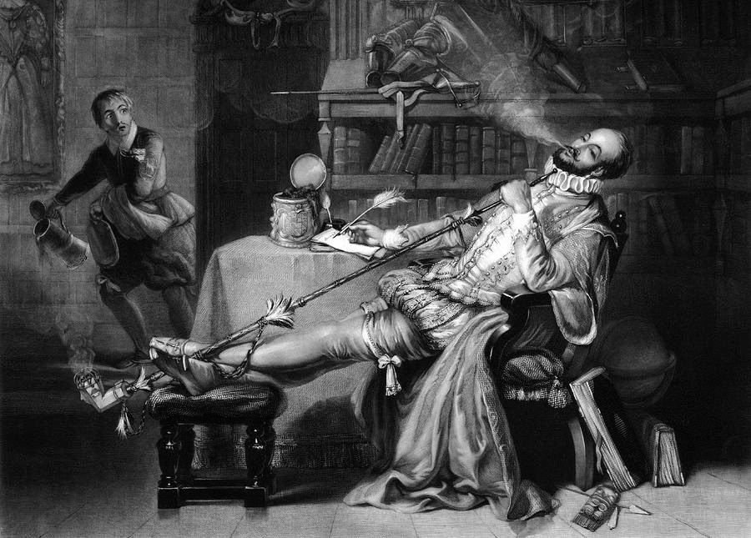
Introduction of nicotine use in the form of tobacco smoking
Notes:
Recognise this is western centric. What we know historically is that tobacco was introduced by the Spanish to Europe. Sir Walter Raleigh introduced Virginia tobacco into England in 1586. at that time, tobacco use was a luxury, seen as a recreational habit . There was no known evidence of any harm, and therefore the consequence was that that there was no need to react or treat. However, as this picture demonstrates, there was the seed of an association with the suggestion of moral corruption

Slide 9
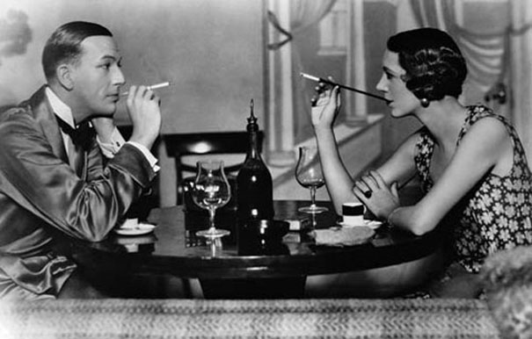
Nicotine use as recreational… Dependence as psychological
Notes:
From the early 1900s through to the 1940s. Occasional tobacco use was seen by society as recreational, and even a marker of social class…Dependent use however was seen as demonstrating a weakness of character or a psychological flaw. The consequences of this view were that we could largely ignore and dismiss nicotine addiction through tobacco use as unworthy, or we could treat excessive use using psychological therapies

Slide 10

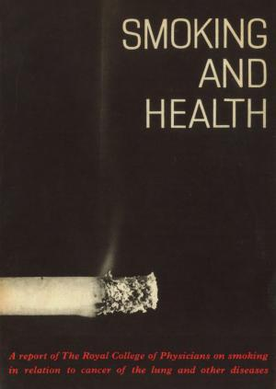
Dependence may be physical?
Notes:
The Royal College of Pyhsiocians reports of 1962 and 1971 reported on the seminal work of Doll and colleagues and made the firm link between smoking and lung cancer, and a strong epidemiological case for the harm of smoking. At the same time there was a increased recognition of the addictiveness of smoking. So there was a recognition that there was perhaps more to dependence than simply a weakness of character?... Could there be a physical ‘cause’.
The RCP report It created a media storm at the time, with an ambivalent, even hostile response from some parts of the media, government and society. Interestingly, the Lancet published some high profile critiques of the methodology of the RCP reports.
The consequence of the emergence of this knowledge was that, in some way, nicotine dependent users were let ‘off the hook’ of being psychologically flawed? If nicotine addiction was physical, then it could perhaps they needed treatment

Slide 11
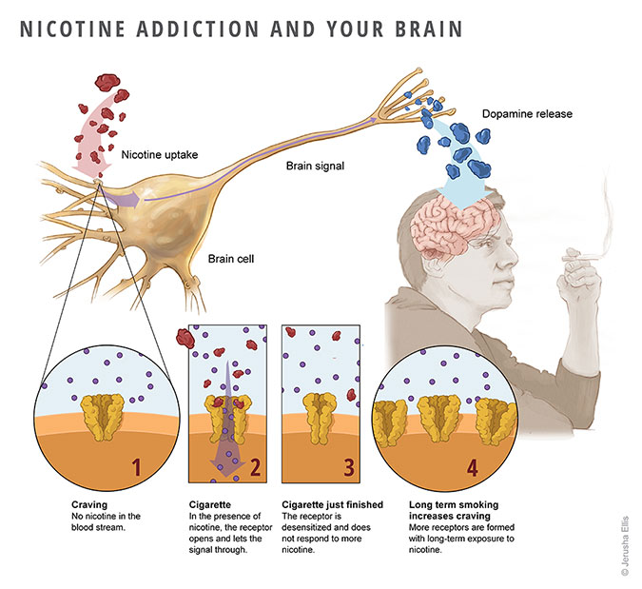

Smoking causes cancer! Treating nicotine addiction with medicine
Notes:
And so it came to be that nicotine was understand to be physically addictive, and the medical model of nicotine addiction as disease came to the fore of public discourse. As a consequence our reaction to nicotine addiction was to terate the disease with medication! NRT was first registered for use in the UK in the 1980s, and since then we have also had varenicline (champix). The gold standard for treatment was to combine medication with behavioural support to stop smoking, and specialist stop smoking services were established in the UK in 1999-2000.

Slide 12
But addiction is more than physical!
Psychosocial model of addiction as adapted for the ECtra study:
Physical
Nicotine addiction, ‘benefits’ of smoking (appetite and weight control)
Social smoking as a group behaviour, association of smoking with particular environments, cues/associative learning
Cultural smoking norms
Psychological Beliefs about use and function of smoking (stress, anxiety)
Identity
Notes:
However, we now know of course that addiction is far more than a medical disease. Here I present a psychosocial model of nicotine addiction that we refer to in our Ectra study. As a consequence of this theoretical view foregrounding cultural and social influences alongside physical and psychological influences on nicotine using behaviour, it is clear that medical treatment for nicotine addiction can only get us so far. Different approaches are clearly needed beyond medication (which attends to the physical need of nicotine addiction), as also we need to attend to phycological, cultural and social needs. And this is especially important when we think about maintaining abstinence from tobacco smoking.

Slide 13
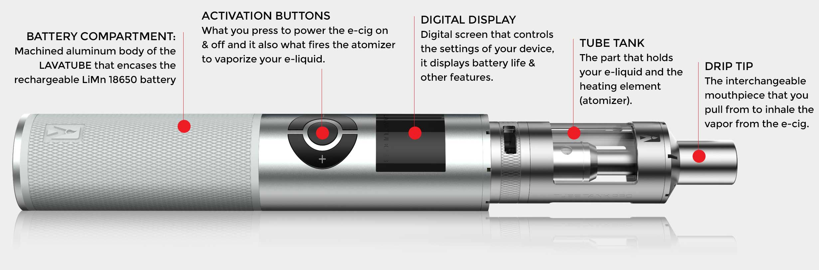

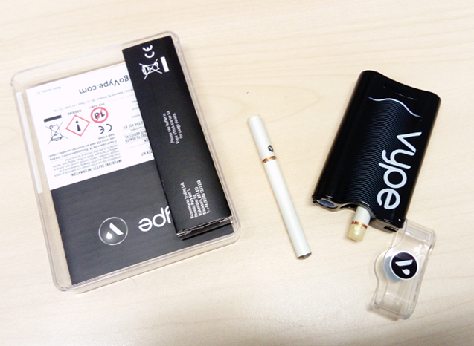
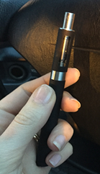
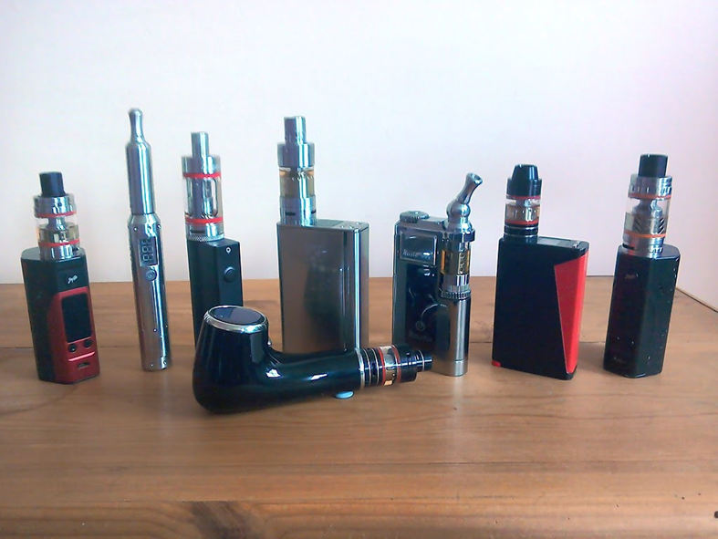
Electronic cigarettes: a consumer product and a ‘disruptive technology’ – an opportunity for relapse prevention
1st Gen.
Cig-a-like
2nd Gen.
Vape pen
3rd Gen.
Mod & Tank
Notes:
Now of course we have the electronic cigarette and other forms of nicotine delilvery devices. These are primarly consumer led products, attractive potentially to whole groups of people otherwise not likely to stop smoking. They offer a rapid form of nicotine delivery, and devices improving all the time. Mimic cigarettes for the nicotine delivery, but also the behavioural action, the social element, and possibly meet an identity need (continuum of smoker identity, or a whole new ‘vaper’ identity? Work published by Ann McNeill in 2015 established that most current e-cigarette users state that they use e-cigarettes for smoking cessation or to cut down from smoking, In the Ectra study due to be published in HRJ in 20th June our data demonstrates that e cigarettes may also be a unique harm reduction innovation for smoking relapse prevention. E cigarettes meet the needs of some ex-smokers by substituting physical, psychological, social, cultural and identity related aspects of tobacco addiction. Some vapers reported that they actually find vaping pleasurable and enjoyable – being more than a substitute but actually preferred, over time, to tobacco smoking. This clearly suggests that vaping is a viable long-term substitute for smoking, with substantial implications for tobacco harm reduction

Slide 14
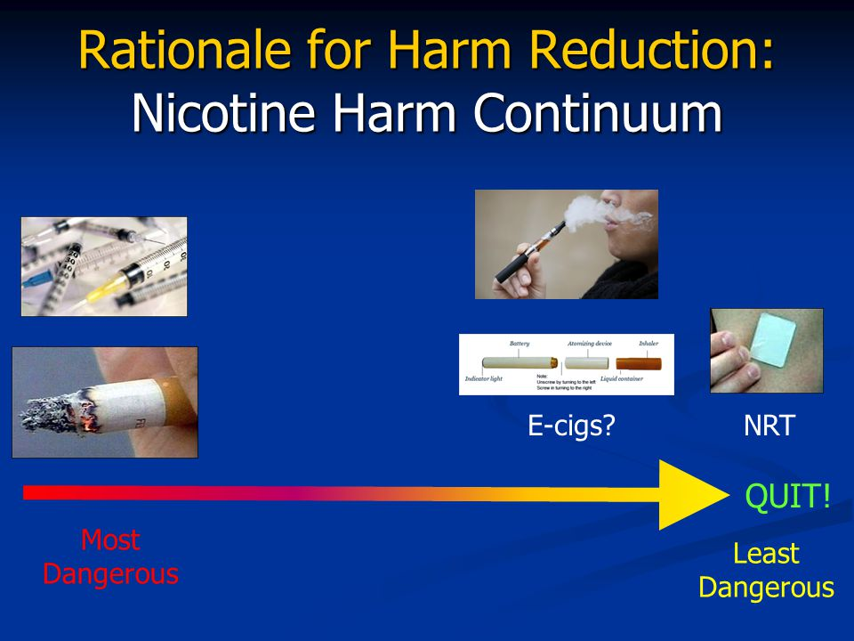
Not all nicotine use is equal – a harm continuum
With thanks to Ann McNeil, KCL
Notes:
So the picture currently is that it is not as simple that addiction to nicotine is bad for health. There is increased understanding that are degrees of nicotine addiction, and degrees of relative harm associated with the form of nicotine delivery

Slide 15
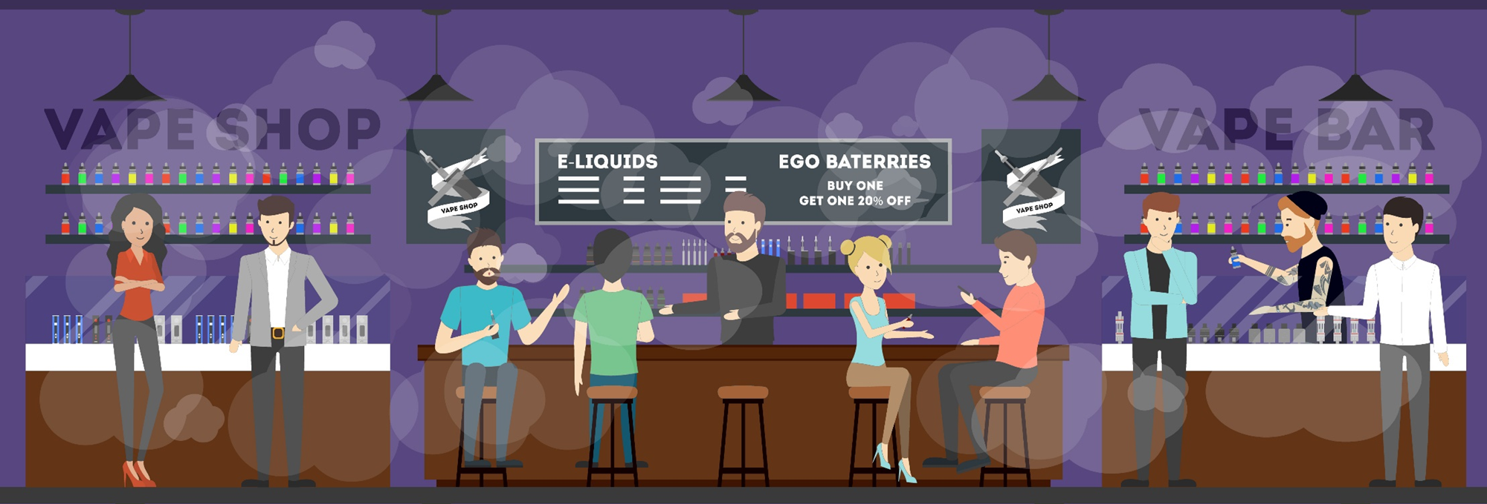
Resurgence of recreational nicotine?
E cigarettes as pleasurable, part of social identity
Vaping not smoking
Notes:
Where we are now? Or where we are getting to? I would suggest that we are experiencing the dawn of a new era where the morally laden societal views of addiction to nicotine perpetuated by the medical model, are shifting, such that addiction to nicotine is coming to be understood by society in isolation from tobacco smoking, and the wider culture is just starting to come around to understanding the possibility of less harmful use of nicotine through alternative nicotine delivery products, particularly e cigarettes. The consequence of this, is that vaping is becoming increasingly accepted by society as a recreational form of nicotine use

Slide 16

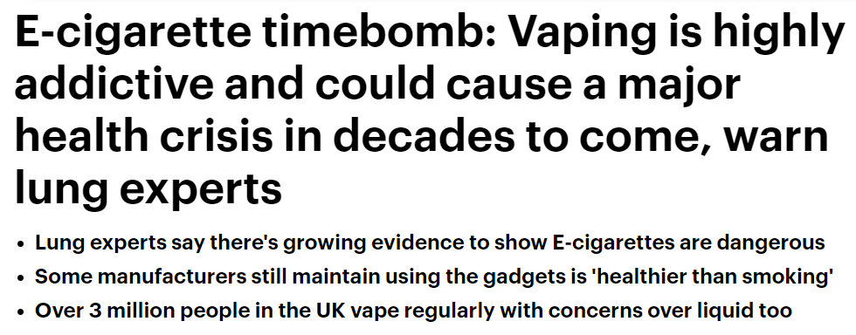
Discourses in dispute
Notes:
However we still have a way to go… this newspaper report I came across just 2 weeks ago… showing that there is still confusion and the wider culture perpetuates public confusion and thus there is a mismatch between actual harm to health of using nicotine separately from tobacco smoking, and myths about vaping as dangerous in its own right. I would suggest that such reporting is corrupt and dangerous, because it is highly influential at a social and cultural level on influencing individual level behaviours, and of course we would wish for dominant societal discourses to encourages individua behaviours which are safer and less harmful where possible.

Slide 17

conclusions
Concurrently we are experiencing a new era for societal and cultural views of nicotine use removed from tobacco smoking. This enables a view of nicotine use as recreational, removed from the lens of previous discourses of nicotine addiction through smoking and significant harm to health.
Notes:
So in conclusion, I have argued that societal and cultural views of nicotine addiction have shifted over time and, in a cyclical nature, we are now experiencing the new dawn of seeing nicotine use as recreational, just as we once saw nicotine use through tobacco smoking as recreational. This suggests that our response to nicotine addiction can now be removed from the medical model which suggests the need for treatment. Clearly, tobacco use is dangerous to health and there should be support and intervention available to help people to switch to lower risk ways of using nicotine. For the future, there remains a question about how we continue to view nicotine use via a less harmful mode of delivery, and that is the future that we have been discussing at this conference, and will no doubt continue to discuss as societal and cultural views emerge and shift over time.

