Slide 1
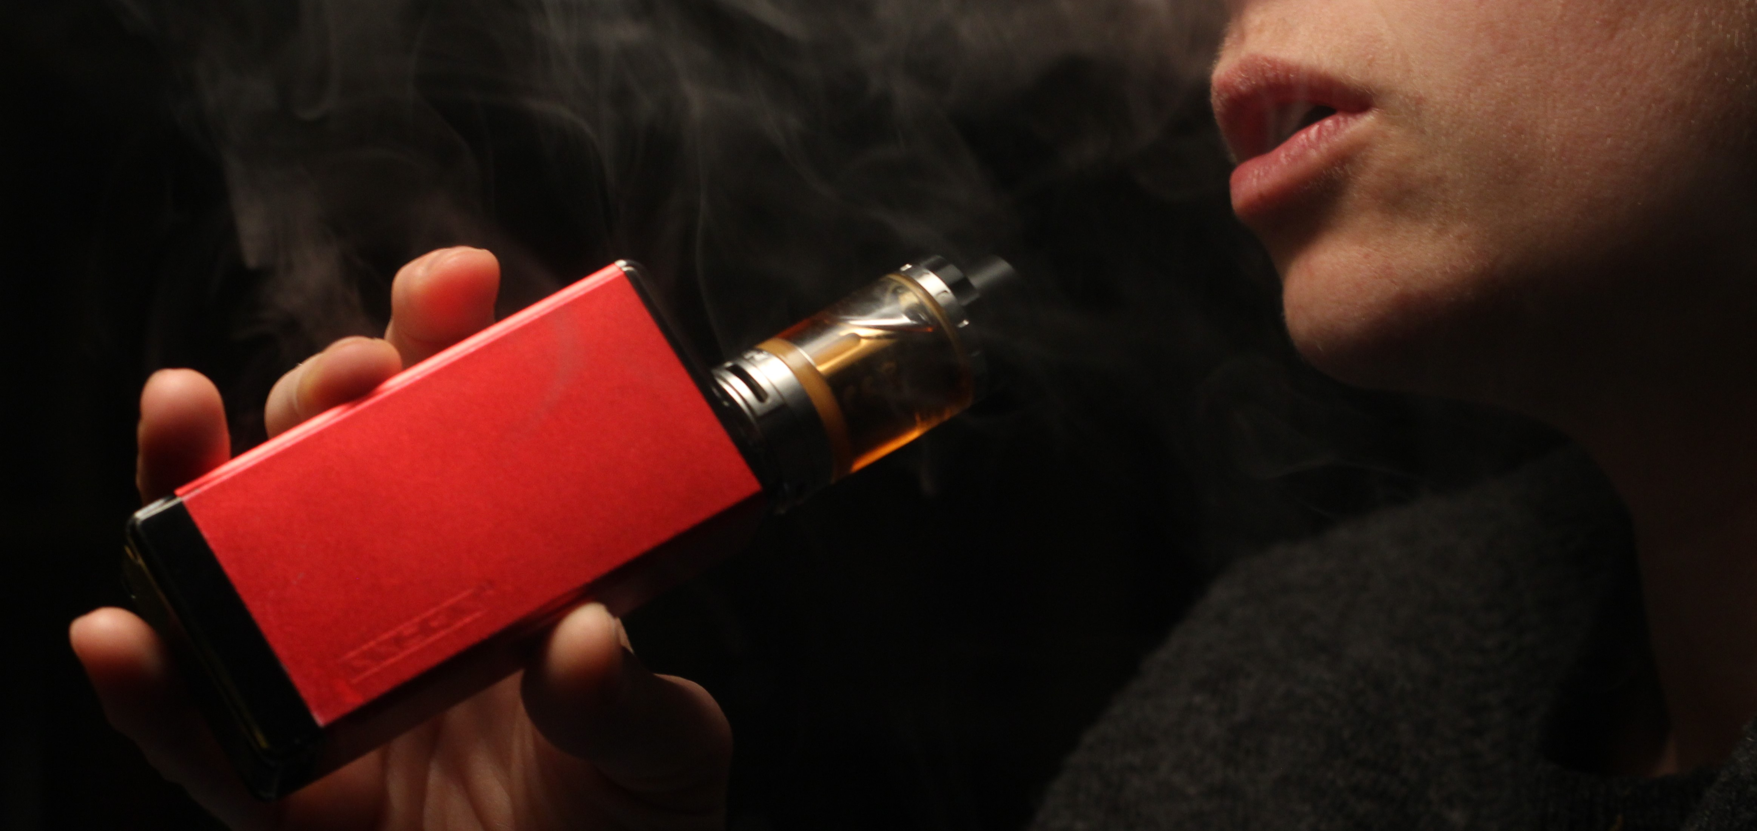




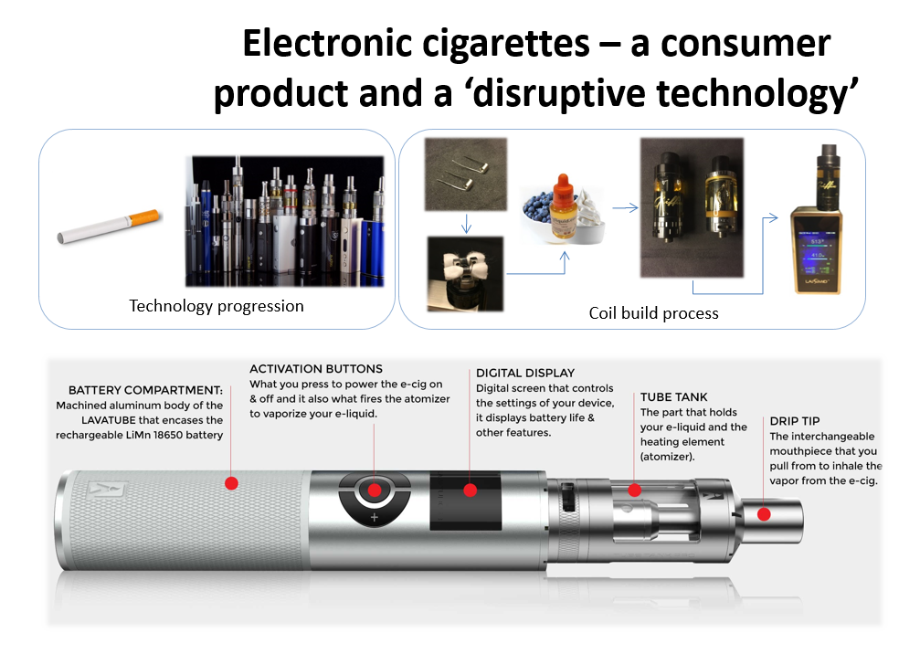
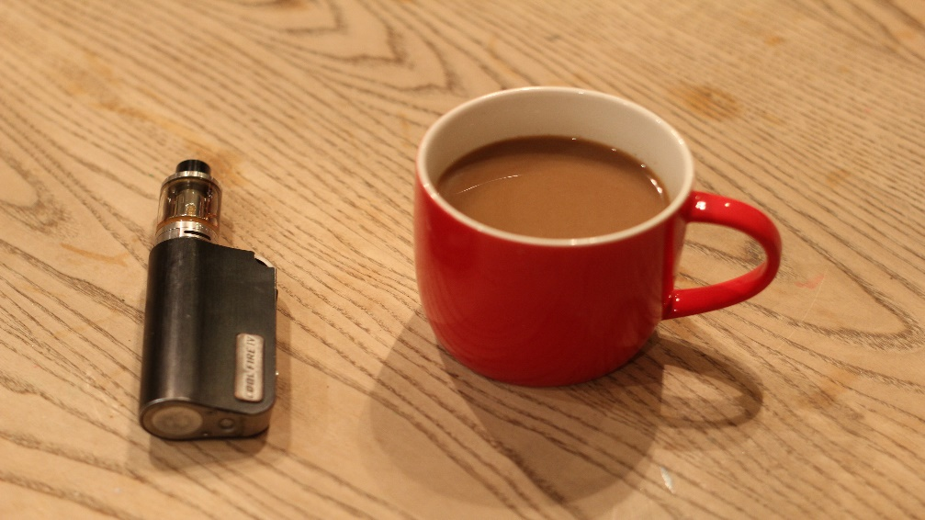







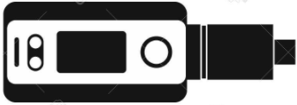
VAPING AS AN ALTERNATIVE TO TOBACCO SMOKING RELAPSE
Dr Caitlin Notley – University of East Anglia, UK c.notley@uea.ac.uk
Dr Lynne Dawkins , London South Bank University
Professor Richard Holland - Leicester Medical School
Dr Emma Ward, University of East Anglia
Sarah Jakes, New Nicotine Alliance
BACKGROUND
E cigarettes are the most popular aid to quitting smoking in the UK (1).
Most quits attempts, prior to e cigarettes, result in relapse to smoking (2).
Most vapers use e-cigarettes for smoking cessation or to cut down (3).
We have little understanding of how vapers use e cigarettes to avoid smoking relapse.
SAMPLING FRAME
 | Achieved sample |  | Target sampling frame
 | % | n | STS % | STS n | Target n
Gender
Male | 50.0 | 20 | 51.4 | 1,205 | 21
Female | 50.0 | 20 | 48.6 | 1,140 | 19
Age (years)
16-24 | 12.5 | 5 | 19.1 | 448 | 8
25-34 | 20.0 | 8 | 26.0 | 609 | 10
35-44 | 30.0 | 12 | 19.4 | 455 | 8
45-54 | 17.5 | 7 | 17.6 | 412 | 7
55-64 | 15.0 | 6 | 10.8 | 253 | 4
65+ | 5.0 | 2 | 7.2 | 168 | 3
Gender and age profile of achieved sample compared to proportion of past-year smokers who had made at least one attempt to quit smoking, surveyed between 2015 and October 2016, in the Smoking Toolkit Study (1)
METHODS
RESULTS
Tobacco smoking lapse is perceived qualitatively differently when using e cigarettes as compared
to past quit attempts.
Having the alternative of vaping meant that full relapse to smoking was not perceived as inevitable following a lapse.
Vaping replicated the pleasure of smoking
Tobacco lapse was perceived as a ‘permissive lapse’, intentional and contextualised, or
For some, tobacco lapse was unintentional, with the resulting emotional response negatively reinforcing ongoing tobacco smoking abstinence.
Permissive lapse
31 abstinent from smoking
19 previous occasional lapses
6 relapsed (some dual using)
3 quit both vaping & tobacco.
“there was part of me that wanted to know if it would be the same or not, and part of me wanted to just sort of, ‘I’ll give it a go and just see what’s what’, and because I was in a very confident position, then I didn’t feel in the slightest bit at risk of sort of regressing, and I think that’s part of what it was actually, it was a sort of, it was a check box to say ‘yes, that’s not a problem’” (M58)
Purposive sample of 40 UK vapers
Matched to a sampling frame from a representative sample of UK quitters
Qualitative thematic analysis of interviews
Data iteratively analysed to situate experiences of smoking lapse within narrative descriptions of vaping.
Vaping replicating smoking
“they’re the perfect replication of smoking, nothing else gives you that, and if you’re like me, and there is a lot of people like me enjoy smoking, the action of it, the feel of it, it becomes, it’s important to you isn’t it? that feeling, and you enjoy it…it is all about the action and that’s the only thing I’ve ever found that replicates it, and that’s why I think if anything happens they ban them, there’s going to be a lot of people going back to smoking” (F34)
CONCLUSIONS
REFERENCES
West, Robert & Brown, Jamie. Smoking in England 2017-2014: Smoking toolkit study [Internet]. 2015 [cited 2017 Nov 15]. Available from: www.smokinginengland.info
Hajek P, Stead LF, West R, Jarvis M, Hartmann-Boyce J, Lancaster T. Relapse prevention interventions for smoking cessation. Cochrane Database Syst Rev. 2013 Aug 20;(8):CD003999.
McNeill A, Brose LS, Calder R, Bauld L & Robson D (2018). Evidence review of e-cigarettes and heated tobacco products 2018 A report commissioned by Public Health England.
COI statement: No conflicts of interest to declare.
This analysis suggests that the role of smoking lapse is theoretically redefined, drawing on novel data from ex-smokers in the context of vaping. These findings theoretically develop our conceptual understanding of smoking lapse in the context of vaping.
IMPLICATIONS
Vaping offers a viable substitution option for smoking and an alternative to relapse.
If tobacco smoking lapse in the context of vaping does not predict relapse, we need to consider redefining how we record lapse/relapse in clinical trials

