Slide 1
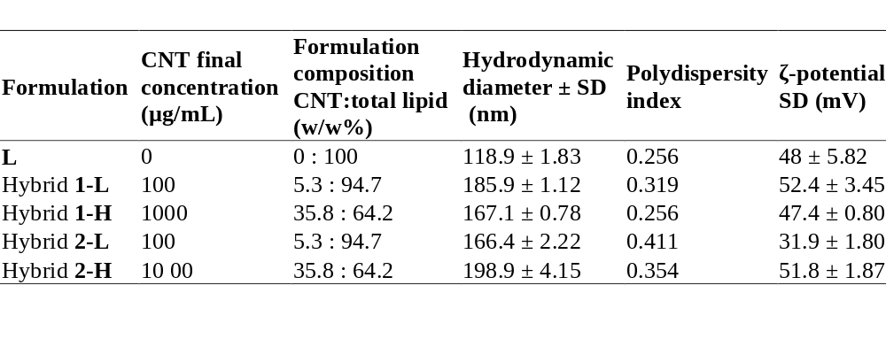
Table 1

Slide 2
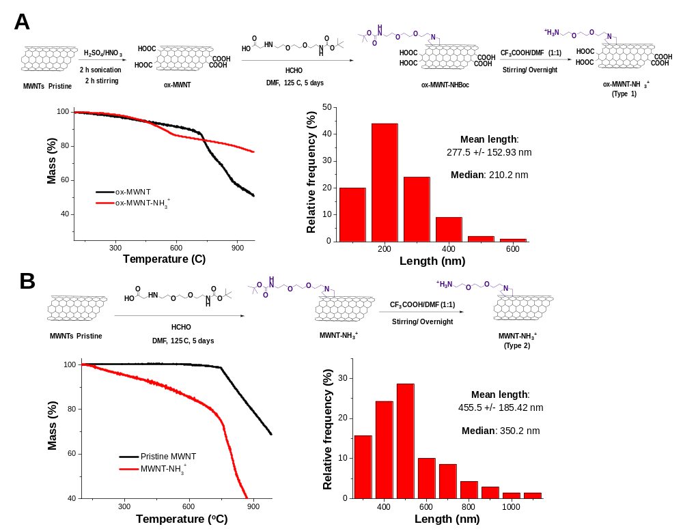
Figure 1

Slide 3
L
1-H
Figure 2

Slide 4
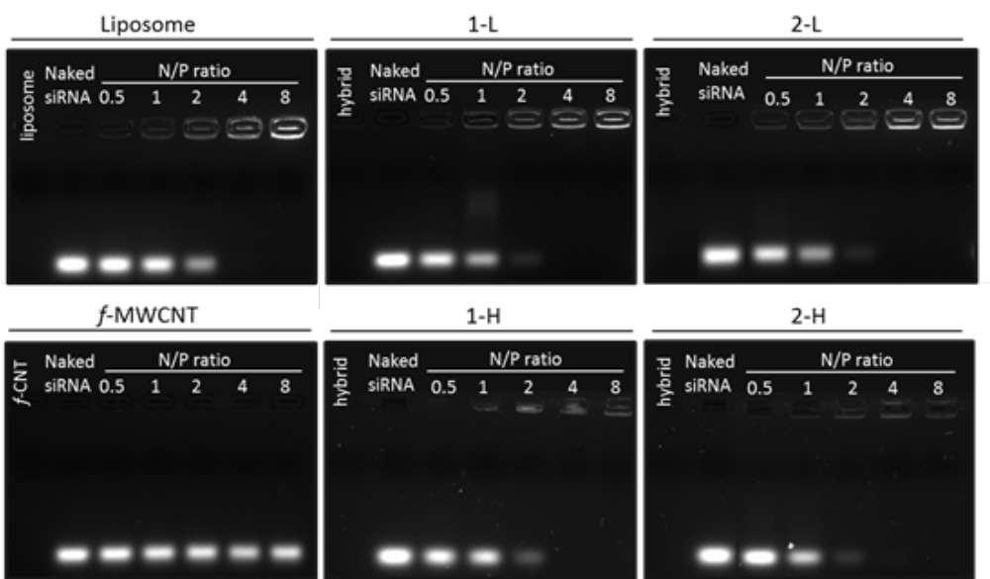
Figure 3

Slide 5
a
b
c
Figure 4

Slide 6
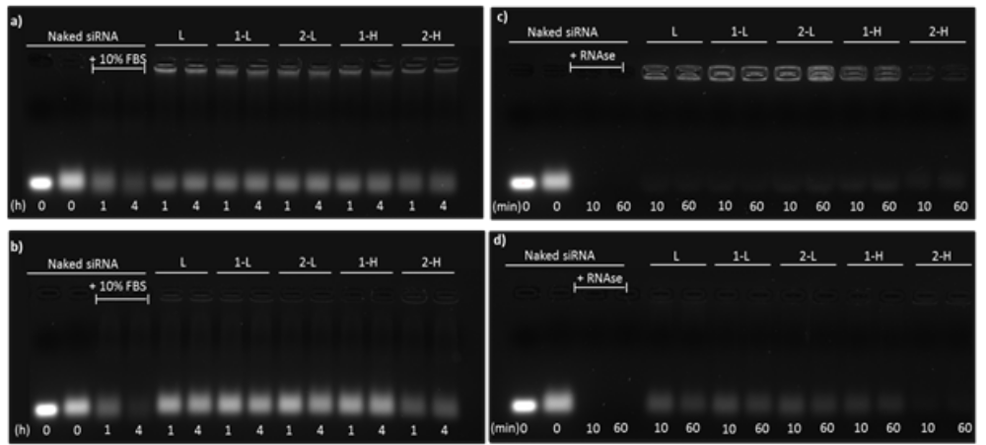
Figure 5

Slide 7
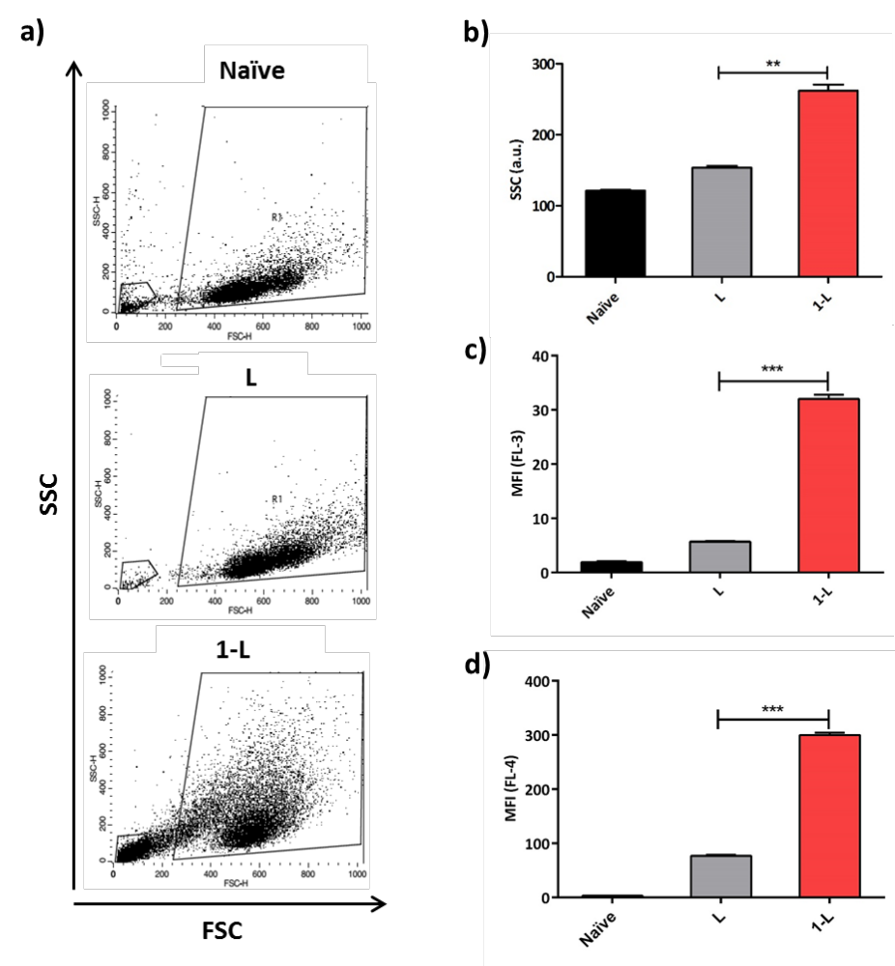
Figure 6

Slide 8
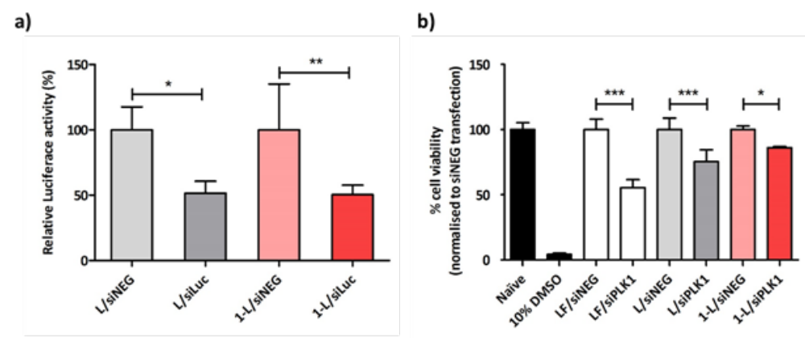
Figure 7

Slide 9
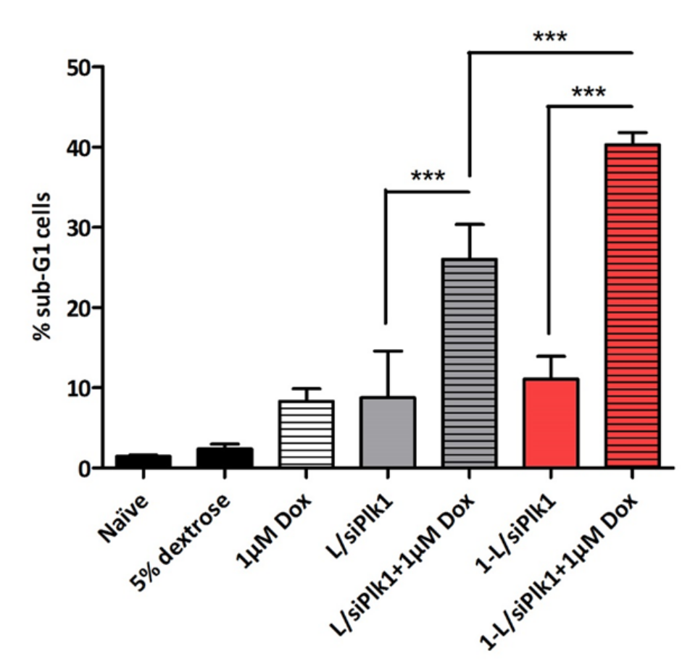
Figure 8

