Slide 1
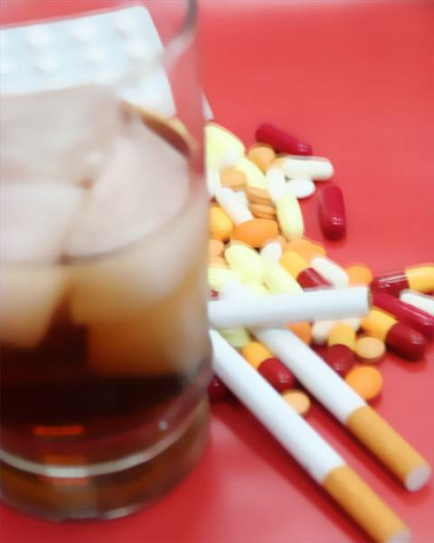



Substance misuse in the undergraduate medical curriculum – local implementation of a national curriculum priority
Notley, C.J., Holland, R.H., Pinto, H., Goodair, C.
School of Medicine, Health Policy & Practice, University of East Anglia & St George's Hospital Medial School, University of London
c.notley@uea.ac.uk; cgoodair@sgul.ac.uk
1. recognise, assess and understand the management of substance misuse and associated health and social problems and contribute to the prevention of addiction.
2. be aware of the effects of substance misuse on their own behaviour and health and on their professional practice and conduct.
3. challenge the stigma and discrimination that are often experienced by people with addiction
Aims of the project
- on graduation students should be able to:
Substance misuse is one of the worst health problems doctors encounter daily.
Every GP deals with over 350 heavy drinkers each year.
Alcohol misuse is in virtually every hospital department. Alcohol is responsible for c.25% of all hospital admissions and c.35% of Accident and Emergency Department attendances (increasing to 70% at peak times).
In England and Wales, there are over 250,000 problem drug users.
1 in every 12 GP registered patients report using illicit drugs at some time within the previous year.
Doctors have a vital role to play in recognising substance misuse, and in assessing and managing the associated problems.
Background
The context of the undergraduate medical curriculum at the University of East Anglia
PBL based course,
supporting lectures and seminars
1 day primary care placement each week, starting from week 1 of the course.
Secondary care and specialist placements, e.g. 2 days placement in a drug clinic
Consultation and clinical skills training
‘year’ lectures, covering topics and course themes relevant to whole year group
Weekly time for independent and group based learning.
The course is organised around 14 ‘systems based’ modules:
Module 01 - Being a Doctor / Patient
Module 02 - Locomotion
Module 03 - Blood & Skin
Module 04 - Circulation
Module 05 - Respiration
Module 06 - Homeostasis / Hormones
Module 07 - Senses
Module 08 - Nutrition / Digestion
Module 09 - Reproduction
Module 10 - Growth & Development
Module 11 - Elective
Module 12 - The Mind
Module 13 - Emergency Care
Module 14 - Preparation for F1
Curriculum change implementation - A brief summary of key changes
Module 1: A new module learning outcome focuses on sources of help and support :
‘Understand the concept of professional behaviour and the importance of self care as a Doctor. Know where to go for help with self care issues
Module 2: An iatrogenic addiction specific learning objective was linked to prescribing for chronic low back pain.
Module 3: Substance misuse was included as a risk factor for DVT.
Module 5: Recommendations to Include some substance misuse specific content (wider than tobacco smoking) are being pursued for the next academic year
Module 7: Substance misuse included within loss of consciousness PBL case.
Module 8: Medical council on alcohol handbook referenced .
Module 9: New learning objective: ‘advise addicted women on how to stabilise / discontinue substance use to minimise impact on foetal and maternal health’.
Module 10: A guest lecture from an outside service covering adolescent substance misuse is to be included in future years.
A new consultation skills scenario dealing with adolescent substance misuse was incorporated for the current academic year.
Module 12: 10 new objectives map to the national learning objectives, covering:
Epidemiology
Aetiology
Identification and assessment
Knowledge of misuse d substances
Dual diagnosis
Pharmacological treatment for addiction
Psychological treatment for addiction
Legal aspects of substance misuse
Drug treatment policy and philosophy
Stigma
Two new lectures were written with a more case / care pathway orientated focus. It is hoped that discussion of the cases in addition to the patient contact in the clinical attachment will start to challenge some of the stigma associated with substance use
Module 14: A substance misuse case is to be included in future years as a complex ‘difficult scenario’.
National mapping matrix used to identify areas for curriculum change and strengths in existing curriculum
Completed May 2010
Overview
Module lead meetings
Presentations to curriculum design and delivery meetings
Negotiations with year leads
embedded within teaching
Completed Sept 2010
Curriculum Change
Project Evaluation
Curriculum Mapping
Student views on substance misuse teaching
Student feedback on substance misuse teaching was undertaken at the end of the academic year 2009-2010. Course evaluation questionnaires and focus groups were undertaken.
Students reported more confidence across all the years in the areas of professionalism and self care and epidemiology/public health.
Confidence in clinical assessment and students own confidence in dealing with substance misuse issues varied , peaking in year 2 but dipping in years 3 and 4.
Results suggested that the focus for change implementation in year 4 in particular (within the reproduction and growth and development modules) was appropriate.
Substance misuse specific teaching within the psychiatry module in year 5 has undergone significant change in response to the curriculum mapping and student review.
UEA evaluation
National evaluation working group
(Commenced Sept 2010)
Conclusions
The project has been successful in highlighting key areas where course based changes were necessary.
Changes to PBL cases and modified learning objectives map directly to the national guidance.
Some new learning objectives were added to modular course material.
Resources shared to support student learning.
The process of curriculum development is
  Dynamic, meeting the needs of undergraduate medical students,
  Responsive to changing policy contexts
  Reflecting the diverse practice landscape .
Sustaining the substance misuse curriculum development project is of key importance in both the medium and longer term.
References: Substance Misuse in the Undergraduate Medical Curriculum, International Centre for Drug Policy 2007.
http://www.dh.gov.uk/en/Publicationsandstatistics/Lettersandcirculars/CMOupdate/DH_4081831 Chief Medical Officer’s Update; 38, May 2004
Lind, J., Kouimtsidis, C., Reynolds, M., Hunt., Drummond, C and Ghodse H (2003) Drug misuse among patients admitted to a general hospital. Journal of Substance Use 8(3), 186-190
Choosing Health – making healthy choices easier, White Paper, HMSO 2004
The Prime Ministers Strategy Unit (2004). Alcohol Harm Reduction Strategy for England http://www.cabinetoffice.gov.uk/media/cabinetoffice/strategy/assets/caboffce%20alcoholhar.pdf
National Drug Treatment Monitoring System statistics, June 2006 (www.ndtms.net)
Acknowledgements
With thanks to the funders, the Department of Health (England), the National project coordinators: International Centre for Drug Policy at St George’s, University of London. Thanks also to UEA module leads, Professor Hamid Ghodse (St George’s) and curriculum coordinators from all English participating medical schools.

