Slide 1










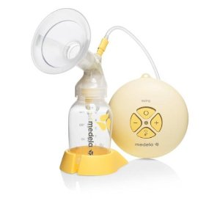
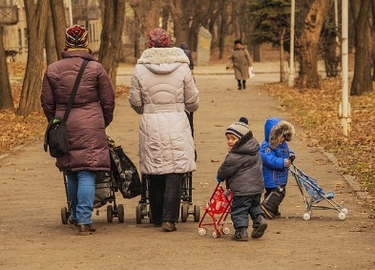
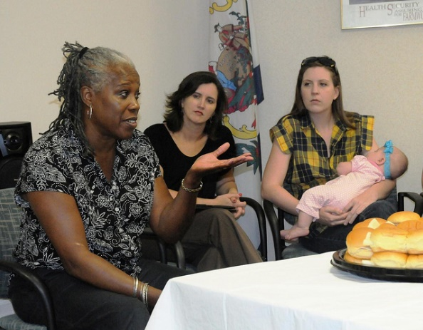

Emma Ward | Dian Nostikasari | Allison Kurti | Jamie Payton | Angelos Kassianos | Claire Adams Spears | Fiona Michell | Caitlin Notley
Staying Healthy AfTer Childbirth
A theory based survey of UK and USA HCPs views on the promotion of smoking cessation and interrelated cancer preventative behaviours postpartum
Introduction
Across the UK and USA, postpartum smoking relapse rates are high for women who quit smoking during pregnancy: up to 75% at 12 months¹⁻³. Simultaneously, rates of exclusive breastfeeding and physical activity are low. These three cancer preventative behaviours have complex interactions, for example, smoking relapse often corresponds with discontinuing breastfeeding⁴⁻⁶, and breastfeeding can be seen as a barrier to physical activity⁷.
Study aim: Underpinned by the social ecological theoretical framework (Figure 1), Project HATCH aims to assess interrelated factors impacting continued smoking abstinence and increased rates of breastfeeding and physical activity among postpartum women.
Results: HCP’s importance ratings of socio ecological factors affecting the three target behaviours (not smoking, breastfeeding, and physical activity)
Results: HCP Suggestions for interventions simultaneously targeting the three behaviours (not smoking, breastfeeding, and physical activity) categorised using social ecological theoretical framework
Individual
Information on how the 3 target behaviours relate to each other App targeting all three behaviours and signposting to support HCPs helping mothers recognise that the postpartum period offers opportunity for positive lifestyle changes Information about combining behaviours e.g. how to fit in exercising when breastfeeding, what is safe exercising whilst feeding, encourage exercise as a distraction from smoking. Realistic antenatal provision addressing emotional challenges of parenthood Incentives for all three behaviours
Interpersonal
HCPs involve and inform partner and family members about postpartum health support Peer support by supporters who have experience of all 3 target behaviours Postnatal ‘health and wellbeing’ support groups covering range of health behaviours Social media postnatal wellbeing groups
Organizational
Consistent and communicative HCP team around the mother Training on 3 target behaviours for all HCPs working with postpartum women Early postpartum home visits
Community
More local community based resources Community groups for women focusing on wellbeing and healthy behaviours Normalisation of 3 target behaviours – education from early age, celebrity role models, media exposure, realistic marketing
Societal
More state funding supporting mothers in postpartum period (e.g. children’s centres) Longer full paid maternity leave
Societal
Public policy, laws, regulations
Community
Culture, values, norms
Organizational
Social institutions,
local policy
 | Stress relieve, confidence, enjoyment
 | Influence of family, peer support
 | Certain policies or other supports at work, in the healthcare system, in daycare centers
 | Access to places where they can be comfortable in breastfeeding with opportunities to walk and away from smoking environment, being part of a broader community that values healthy and active lifestyle
 | Laws requiring employers to provide certain amount of maternity/parental benefits, smoking/tobacco-free policy, or incentives to exercise
Interpersonal
Families, friends, social networks
Individual
Knowledge, attitudes, skills
Figure 1: Social Ecological Theoretical Framework Model
 | Stress, lack of confidence, lack of enjoyment
 | Lack of support from family, friends, and other peers
 | Insufficient policies or other supports at work, in the healthcare system, in daycare centers
 | Not having access to places where they can be comfortable in breastfeeding with opportunities to walk and away from smoking environment, not being part of a broader community that values healthy and active lifestyle
 | Insufficient laws requiring employers to provide certain amount of maternity/parental benefits, smoking/tobacco-free policy, or incentives to exercise
Methodology
Project HATCH is a multimethod study including:
  Phase 1: A scoping review of existing postpartum support resources, and systematic literature review of interventions.
  Phase 2: A survey of healthcare professionals (HCPs)
  Phase 3: Qualitative focus groups with postpartum women
  Phase 4: Intervention development
Phase 2 of the study is presented here: An online survey of UK and USA health professionals to elicit their views on current practice relating to target behaviours (smoking relapse prevention, promotion of breastfeeding, physical activity), postpartum. We explore how health professionals rate the importance of these barriers and facilitators for each target behaviour and how the barriers and facilitators are related to each other across the three behaviours. In addition, data are presented on health professionals’ feedback about existing resources and ideas for future improvement.
Survey aim: Explore perceived facilitators and barriers of the cancer preventing target behaviours relating to each ecological subsystem of the social ecological framework (Figure 1).
Results: Existing resources identified by HCPs
Textual support: websites, leaflets, and apps
Telephone helpline support for breastfeeding and smoking
Interactive online support: Forums and social media groups for breastfeeding and physical activity
General and specific HCP support (e.g. lactation consultant, stop smoking advisor, women’s health physio)
Peer support, support groups, walking/exercise groups, breastfeeding friendly cafes
Pump loan and hire, smoking medication/NRT
Conclusion
Willingness and ability to engage in continued smoking abstinence, physical activity and breastfeeding in the postpartum period is affected by physical and sociocultural variables in the larger community environment. There is a need to support women across these interlinked cancer preventative behaviours, within their unique contexts, with potential to significantly impact both maternal and child long-term health outcomes. The results of the survey will contribute to the wider aim of Project HATCH to develop a prototype intervention to target continued abstinence from smoking, alongside increased breastfeeding and physical activity among postpartum women.
None of the existing resources explicitly address the 3 target behaviours simultaneously
Few of the existing resources are aimed at or include partners or extended family
Many of the existing resources rely upon mothers being individually motivated to access them
Respondents to Project HATCH HCP Survey (n=53)
Health Care Professional | %
Midwifery professional | 26
Health visitor/community nurse | 23
Doctor (GP, obstetrician, other) | 17
Children centre worker/charity worker | 9
Breastfeeding counsellor/lactation consultant | 8
Fitness and wellbeing professional | 4
Other | 13
References
1. Hauge LJ, Torgersen L, Vollrath M. Associations between maternal stress and smoking: findings from a population-based prospective cohort study. Addiction. 2012;107(6):1168–73.
2. Kahn RS, Certain L, Whitaker RC. A reexamination of smoking before, during, and after pregnancy. Am J Public Health. 2002;92(11):1801–8.
3. Kong GW, Tam WH, Sahota DS, Nelson EA. Smoking pattern during pregnancy in Hong Kong Chinese. Aust N Z J Obstet Gynaecol. 2008;48(3):280–5
4. Thulier D, Mercer J. Variables associated with breastfeeding duration. J Obstet Gynecol Neonatal Nurs. 2009;38(3):259–68.
5. Simmons VN, Sutton SK, Quinn GP, Meade CD, Brandon TH. Prepartum and postpartum predictors of smoking. Nicotine Tob Res. 2014;16(4):461–8.
6. Rockhill KM, Tong VT, Farr SL, Robbins CL, D’Angelo DV, England LJ. Postpartum smoking relapse after quitting during pregnancy: pregnancy risk assessment monitoring system, 2000–2011. J Womens Health. 2016;25(5):480–8.
7. Evenson KR, Aytur SA, Borodulin K. Physical Activity Beliefs, Barriers, and Enablers among Postpartum Women. J Womens Health. 2009 Dec 1;18(12):1925–34.

